Slide 1
Samba Commerce
Company-Wide Dashboard
Margianto Ramadhani
Week 11&12 - RevoU FSDA JAN23

Slide 2
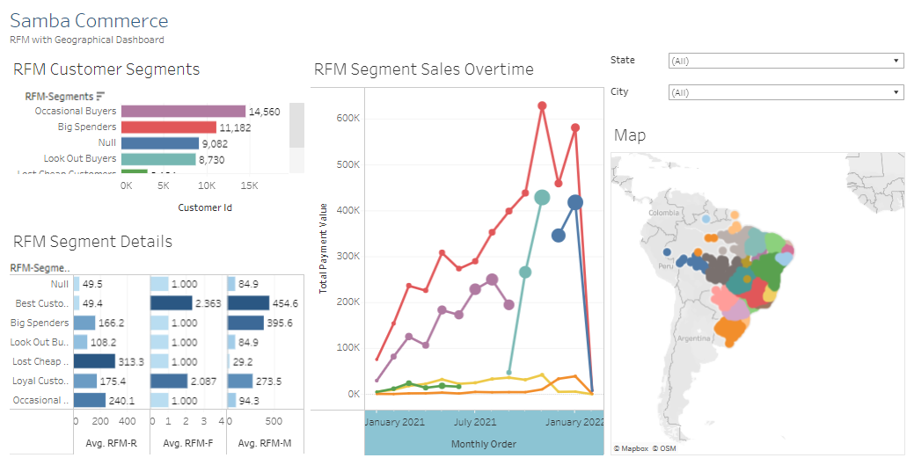
How will user(s) use the dashboard?
Tableau Dashboard
Link to Dashboard
1
1. Dashboard Title
From the title, users can get information what kind of dashboard
3
5
2
3. RFM Customer Segment
User can see the customer segmentation
6
2. Control Filter
Using control filters, users can filter the data based on their needs. On this dashboard, users can filter based on state and city
4
4. RFM Segment Detail
Users can see detail the average of all customer segmentation.
6. Map
Users can see geographical distribution of customer
5. Customer segment sales
Users can see the customer segmentation sales based on total payment monthly

Slide 3
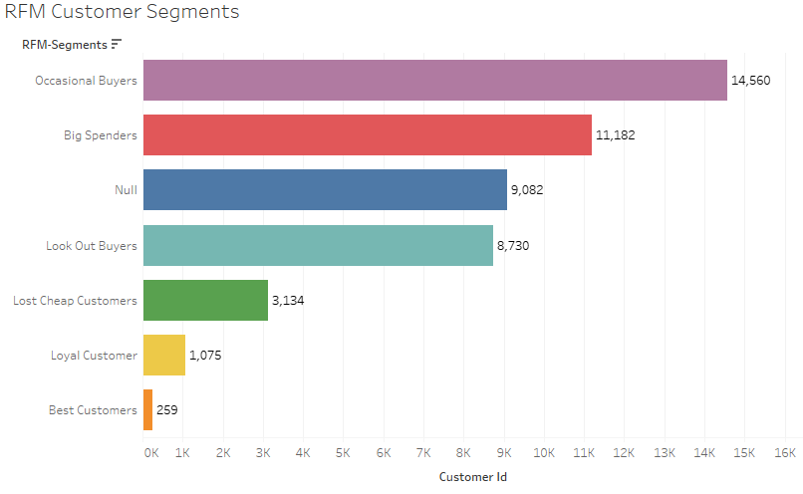
The chart gives an idea about the strength of the customer group in terms of customer counts. Here we can see that Occasional and Big Spenders who purchase occasionally or during a special deal make up the most prominent groups.
Tableau Dashboard - Findings/Insights #1

Slide 4
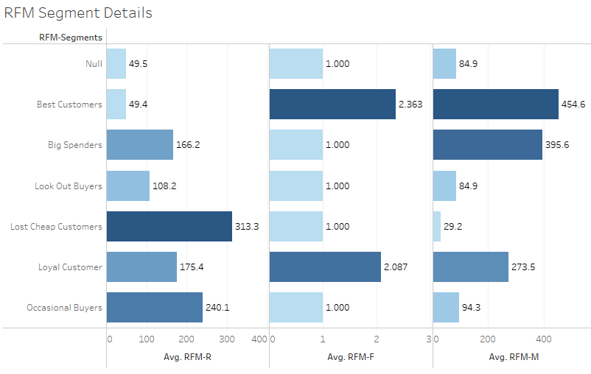
The bar chart provides us with many insights into each customer group. One of them is Best Customers spend an average amount of 454.6, have made ten average purchases, and their last purchase was around 49 days ago.
Tableau Dashboard - Findings/Insights #2

Slide 5
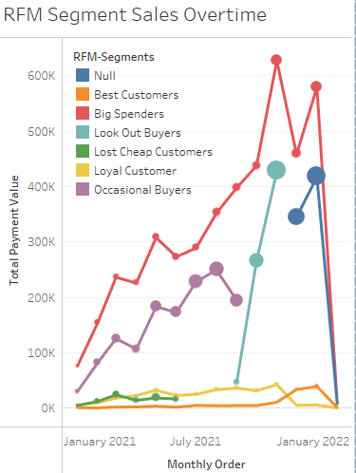
Through this visual, we can notice trends such as the spending of the “Big Spenders” increasing from June to November.
Tableau Dashboard - Findings/Insights #3

Slide 6
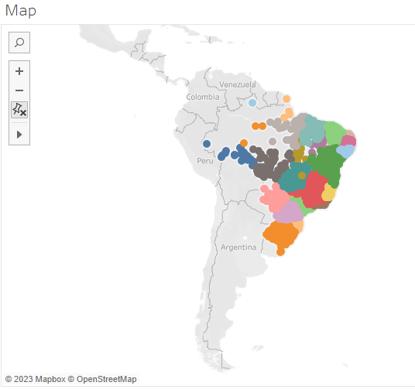
Based on the geographic distribution of customers, it is known that the largest population of customers comes from the Brazilian region.
To get a wider range of customers in other regions, it is necessary to carry out more campaigns and promotions outside the region
Tableau Dashboard - Findings/Insights #4

